Slide 1
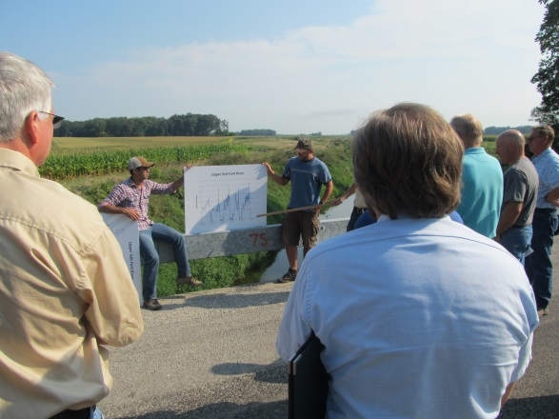
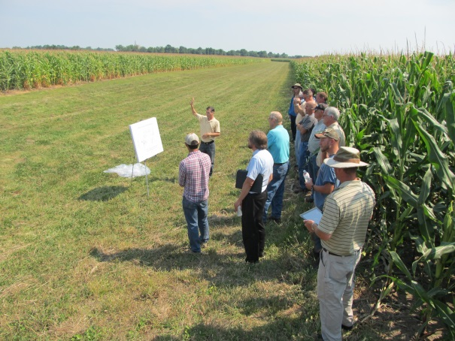
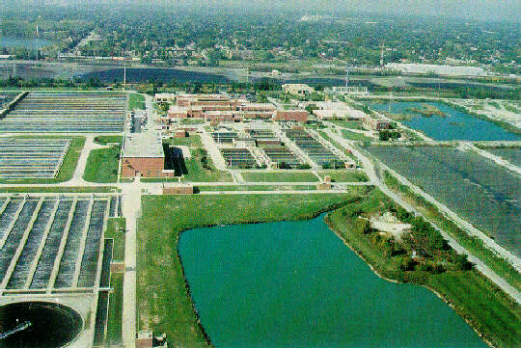
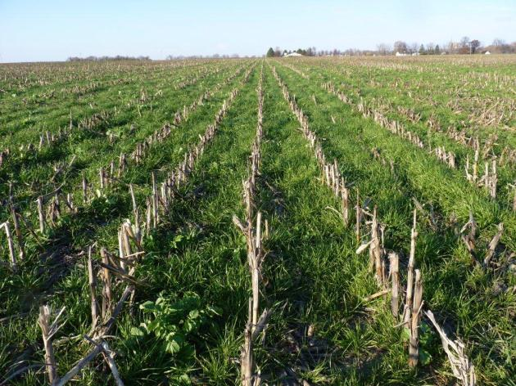
Science Assessment to Support an Illinois Nutrient Loss Reduction Strategy
Mark David, Greg McIsaac, George Czapar, Gary Schnitkey, Corey Mitchell
University of Illinois at Urbana-Champaign
11-08-12

Slide 2
Technical Tasks
develop a science based technical assessment of:
current conditions in Illinois of nutrient sources and export by rivers in the state from point and non-point sources
methods that could be used to reduce these losses and estimates of their effectiveness throughout Illinois
estimates of the costs of statewide and watershed level application of these methods to reduce nutrient losses to meet TMDL and Gulf of Mexico goals

Slide 3
Illinois Riverine Water and Nutrients

Slide 4
Illinois Nutrient Concentrations (average of all rivers in state)

Slide 5
Riverine N and P Fluxes
 | Water | Nitrate-N | Total N | DRP | Total P
 | 10¹² ft³ yr⁻¹ | million lb N or P yr⁻¹
David & Gentry (2000) | 1.6 |  | 538 |  | 31.3
1980-1996 | 1.70 | 404 | 527 | 15.4 | 34.0
1997-2011 | 1.72 | 410 | 536 | 18.5 | 37.5
Urban runoff |  | 6.0 | 8.3 |  | 1.5
Point sources |  | 75.2 | 87.3 |  | 18.1
 |  | Percent of 1997-2011 load
Point sources |  | 18.4 | 16.3 |  | 48
David & Gentry (2000) |  |  | 16 |  | 47

Slide 6
Point and agricultural sources (1997-2011)

Slide 7
Nitrate-N and Total P Targets
Red line is target, purple is average 1997 to 2011

Slide 8
Illinois as % of MRB
20.2
11.3
David and Gentry (2000) 15% for total N, 10% for P

Slide 9
Illinois Nutrient Sources

Slide 10
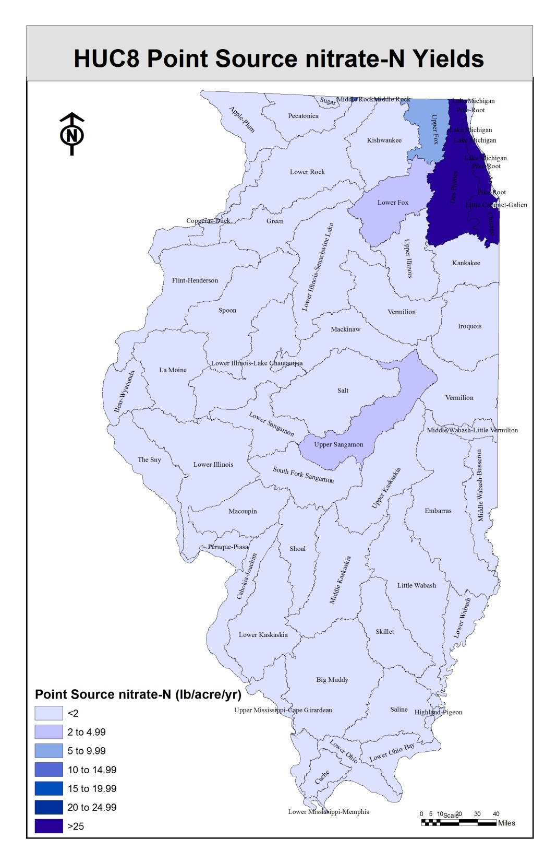
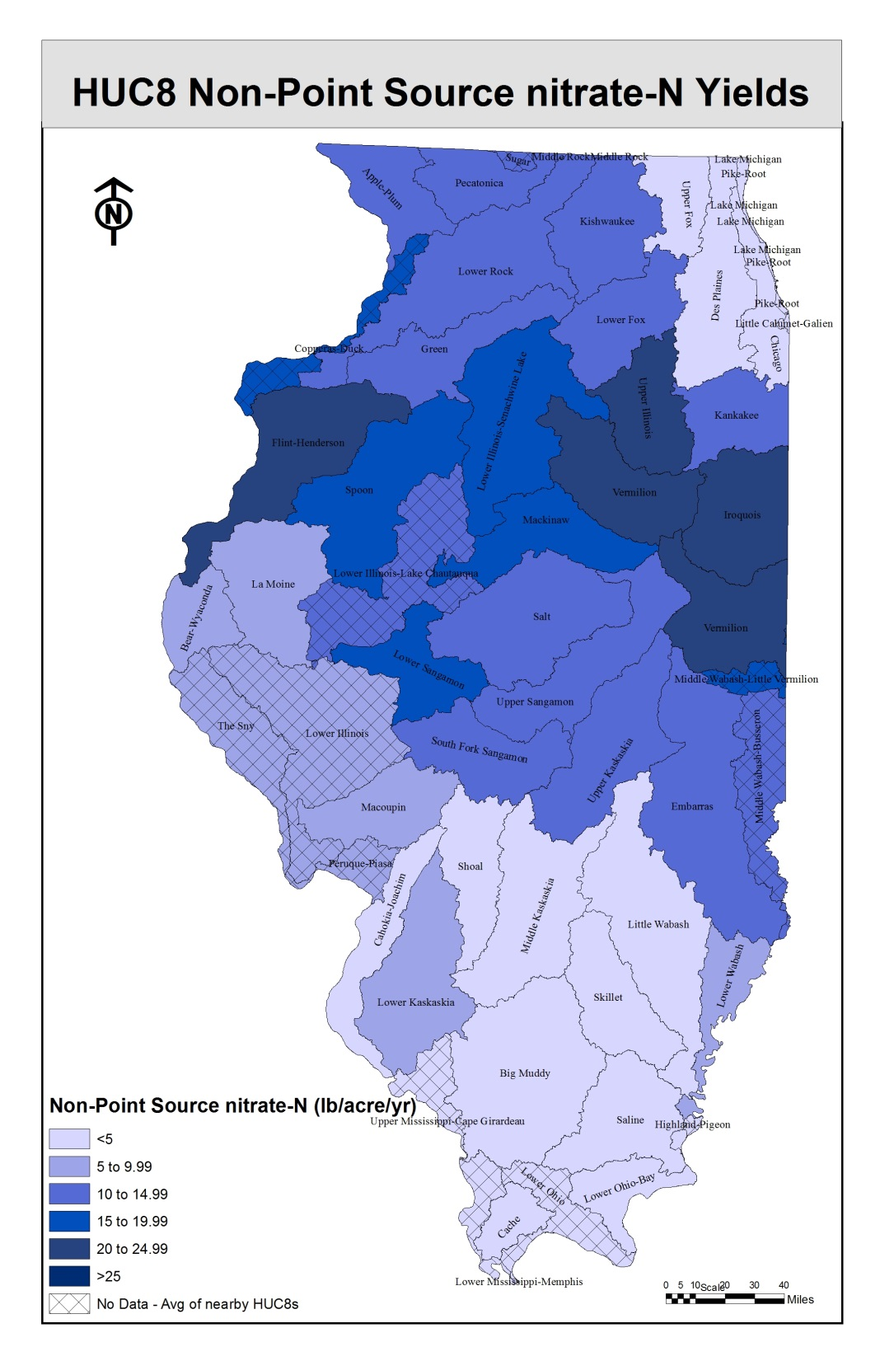

Slide 11
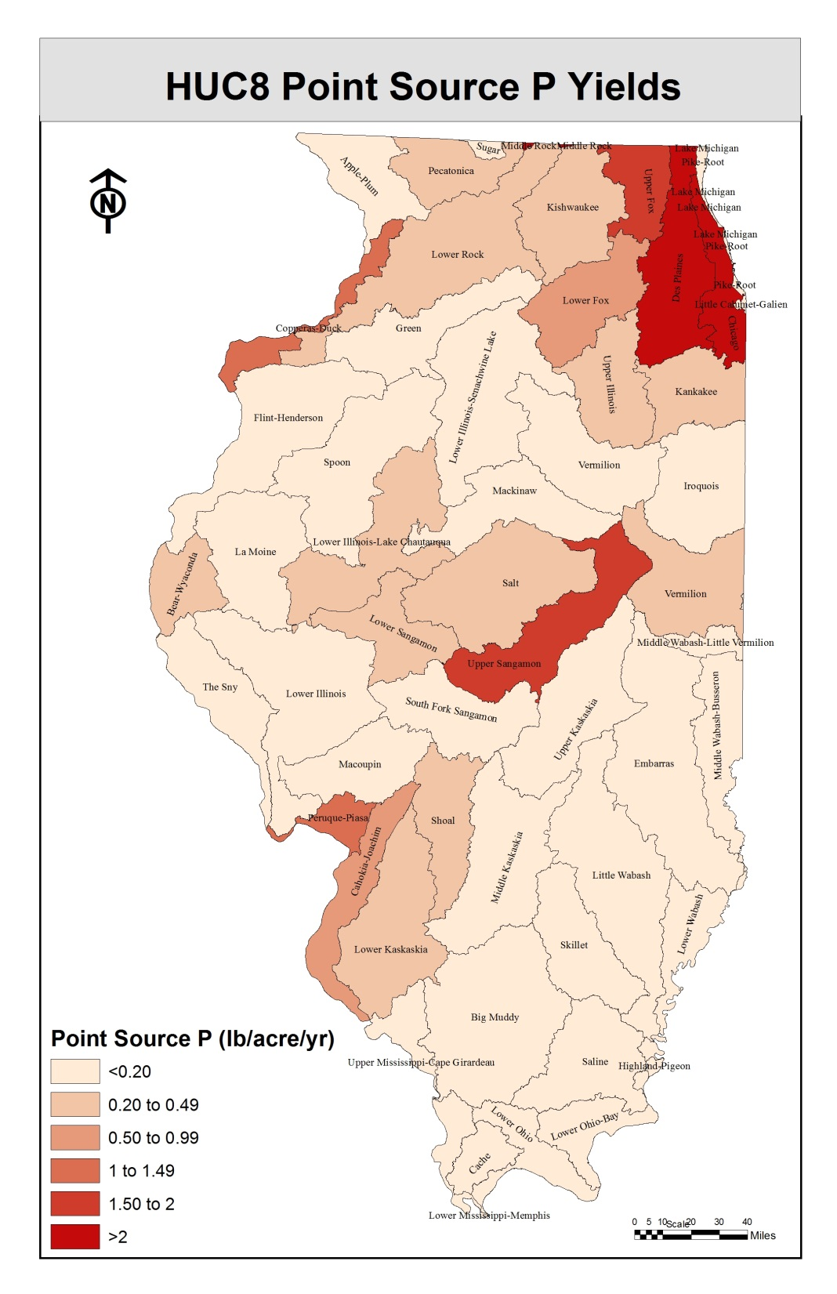
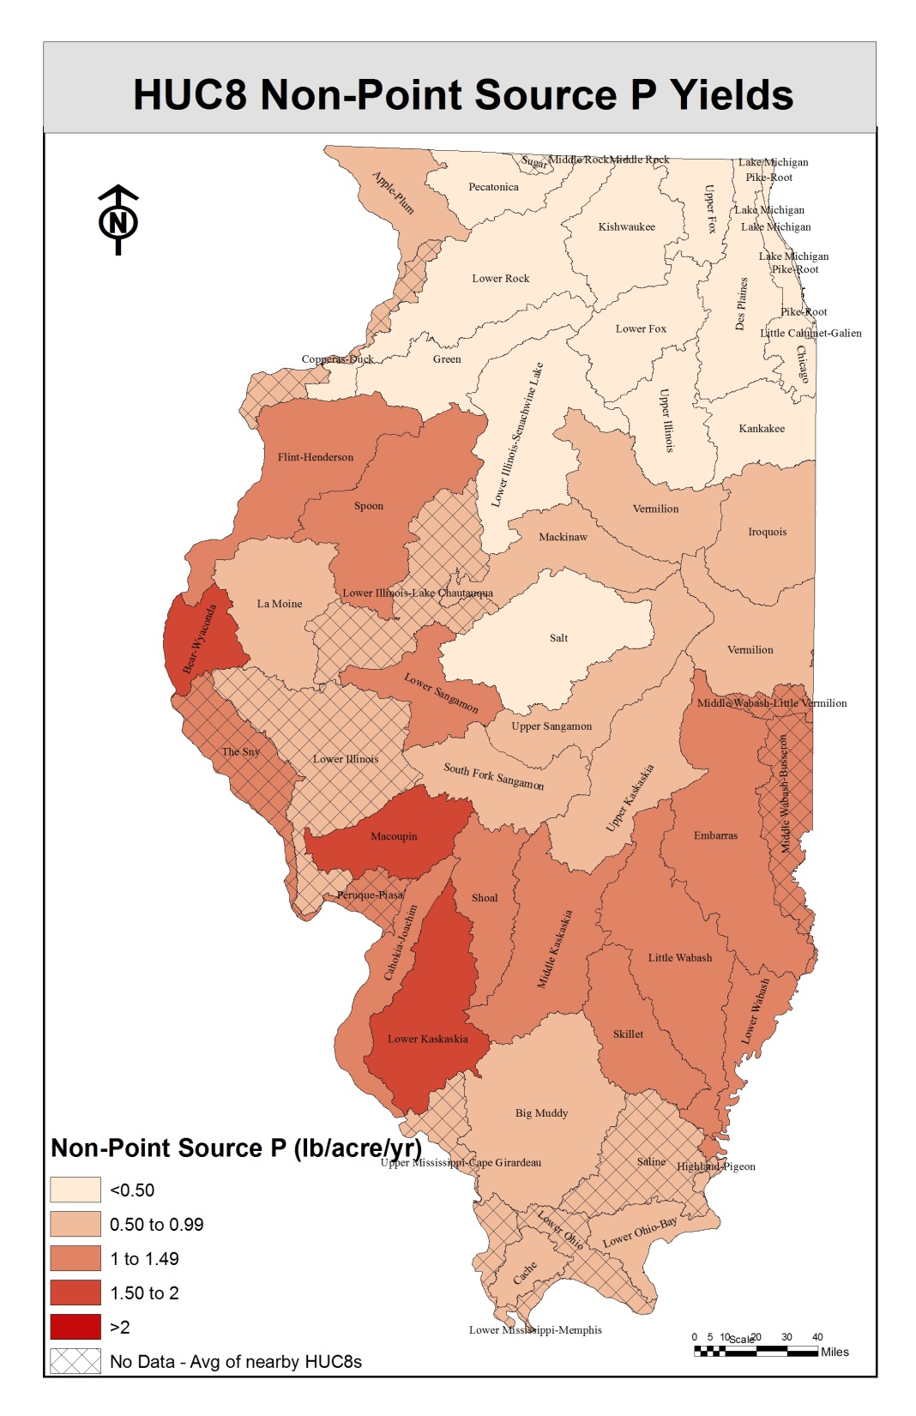

Slide 12
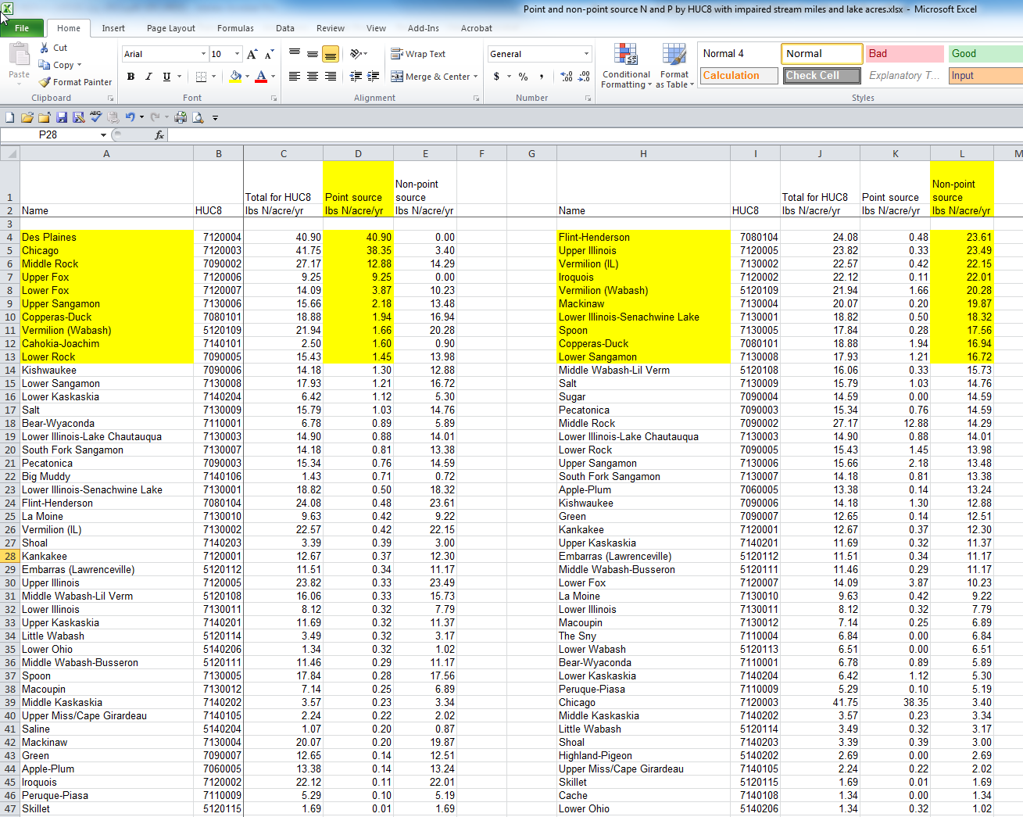

Slide 13
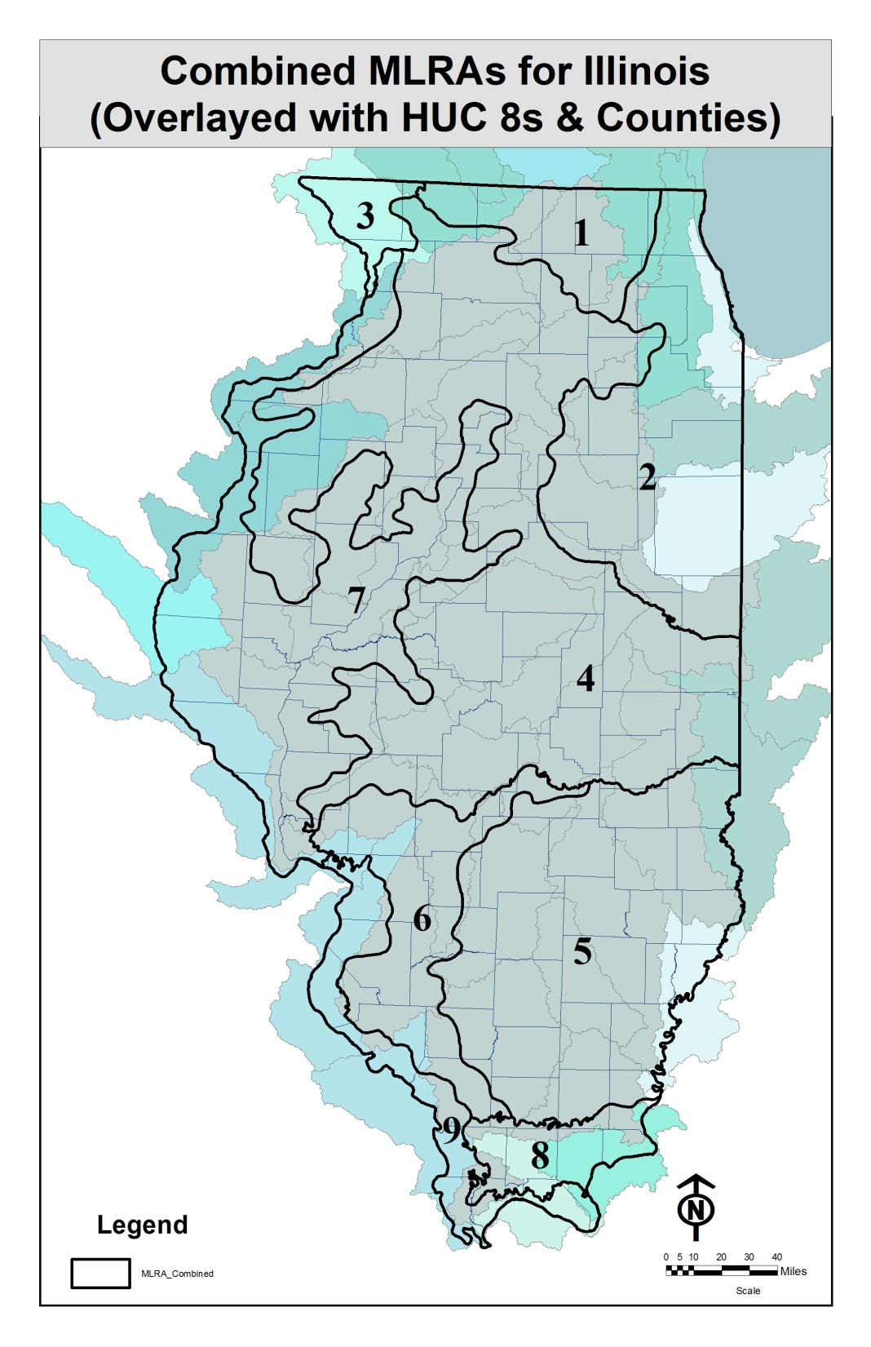

Slide 14
Agricultural Management by MLRA
Combined MLRA | Description | Corn (acres) | Soybean (acres) | Wheat (acres) | Drained acres (% of crop acres) | Corn yield (bu/acre) | Soybean yield (bu/acre)
MLRA 1 | Northern Illinois drift plain | 515,905 | 224,186 | 20,192 | 288,491 (39) | 161 | 48
MLRA 2 | Northeastern Illinois heavy till plain | 1,532,100 | 1,111,885 | 42,404 | 2,063,695 (78) | 150 | 39
MLRA 3 | Northern Mississippi Valley | 163,507 | 52,432 | 1,975 | 20,942 (10) | 160 | 50
MLRA 4 | Deep loess and drift | 5,579,980 | 3,343,444 | 76,078 | 5,437,807 (61) | 164 | 52
MLRA 5 | Claypan | 1,609,633 | 1,991,939 | 352,839 | 310,087 (9) | 128 | 39
MLRA 6 | Thin loess and till | 664,242 | 689,773 | 161,180 | 226,971 (17) | 130 | 42
MLRA 7 | Central Mississippi Valley, Northern Part | 2,058,853 | 1,288,686 | 73,884 | 1,284,588 (38) | 155 | 49
MLRA 8 | Sandstone and shale hills and valleys | 83,969 | 115,244 | 10,658 | 49,565 (25) | 103 | 33
MLRA 9 | Central Mississippi Valley, Western Part | 203,736 | 314,662 | 78,250 | 23,769 (5) | 125 | 39
Sum |  | 12,411,925 | 9,132,251 | 817,460 | 9,705,916 (43)
Average crop acres and yields 2008 through 2012

Slide 15
Agricultural N Management by MLRA
Combined MLRA | Description | Estimated corn fertilizer (lb N/acre/yr) | Estimated corn fertilizer + manure (lb N/acre/yr) | Row crops (acres) | Nitrate-N yield per row crop acre (lb N/acre/yr)
MLRA 1 | Northern Illinois drift plain | 152 | 168 | 760,283 | 20.4
MLRA 2 | Northeastern Illinois heavy till plain | 158 | 164 | 2,686,389 | 25.0
MLRA 3 | Northern Mississippi Valley | 135 | 158 | 217,914 | 31.3
MLRA 4 | Deep loess and drift | 150 | 159 | 8,999,502 | 19.6
MLRA 5 | Claypan | 180 | 196 | 3,954,411 | 6.6
MLRA 6 | Thin loess and till | 156 | 170 | 1,515,195 | 7.4
MLRA 7 | Central Mississippi Valley, Northern Part | 155 | 169 | 3,421,423 | 24.5
MLRA 8 | Sandstone and shale hills and valleys | 209 | 219 | 209,871 | 3.9
MLRA 9 | Central Mississippi Valley, Western Part | 192 | 204 | 596,648 | 4.0
Sum |  | 157 | 168 | 22,361,636

Slide 16
Corn Fertilizer N by MLRA
Combined MLRA | Description | Estimated CS fertilizer + manure (lb/acre/yr) | MRTN (10 to 1) CS (lb N/acre/yr) | Estimated CC fertilizer + manure (lb/acre/yr) | MRTN (10 to 1) CC (lb N/acre/yr)
MLRA 1 | Northern Illinois drift plain | 156 | 146 | 196 | 199
MLRA 2 | Northeastern Illinois heavy till plain | 151 | 155 | 190 | 197
MLRA 3 | Northern Mississippi Valley | 146 | 146 | 184 | 199
MLRA 4 | Deep loess and drift | 147 | 155 | 185 | 197
MLRA 5 | Claypan | 181 | 171 | 227 | 189
MLRA 6 | Thin loess and till | 157 | 171 | 198 | 189
MLRA 7 | Central Mississippi Valley, Northern Part | 156 | 163 | 197 | 194
MLRA 8 | Sandstone and shale hills and valleys | 202 | 171 | 254 | 189
MLRA 9 | Central Mississippi Valley, Western Part | 188 | 171 | 237 | 189
MRTN is Maximum Return to N

Slide 17
Nitrate Yield by MLRA
Combined MLRA | Description | Drained cropland (acres) | Nitrate-N yield per row crop acre (lb N/acre/yr) | Nitrate-N yield per tile drained acre (lb N/acre/yr) | Nitrate-N yield from non-tiled land (lb N/acre/yr)
MLRA 1 | Northern Illinois drift plain | 288,491 | 20.4 | 43 | 6.6
MLRA 2 | Northeastern Illinois heavy till plain | 2,063,695 | 25.0 | 29 | 10.8
MLRA 3 | Northern Mississippi Valley | 20,942 | 31.3 |  | 31.3
MLRA 4 | Deep loess and drift | 5,437,807 | 19.6 | 26 | 9.9
MLRA 5 | Claypan | 310,087 | 6.6 |  | 6.6
MLRA 6 | Thin loess and till | 226,971 | 7.4 | 30 | 3.5
MLRA 7 | Central Mississippi Valley, Northern Part | 1,284,588 | 24.5 | 46 | 11.8
MLRA 8 | Sandstone and shale hills and valleys | 49,565 | 3.9 |  | 3.9
MLRA 9 | Central Mississippi Valley, Western Part | 23,769 | 4.0 |  | 4.0

Slide 18
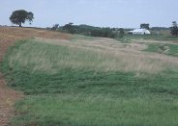
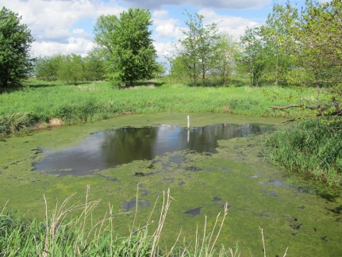
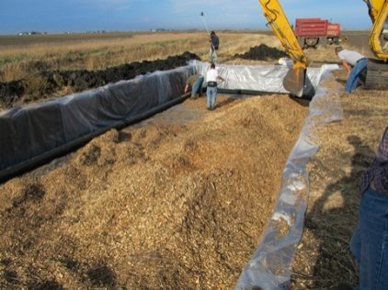
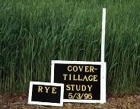
What can we do in agriculture?
given,
it is not typically over fertilization based on current rates and yields
may be zero or negative N & P balances in some areas of the tile drained Midwest
three types of conservation practices could help
nutrient-use efficiency (4Rs)
in-field management
off-site measures

Slide 19
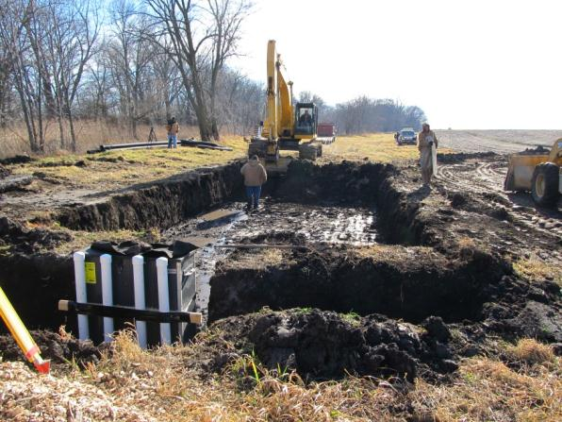
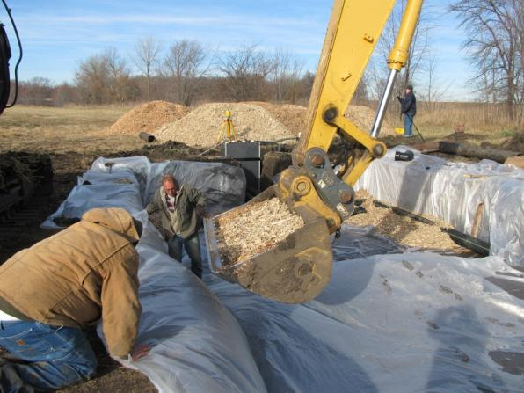
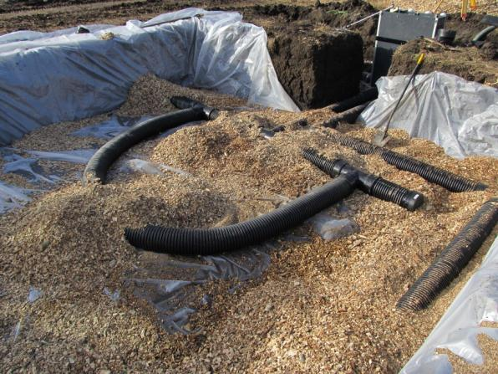
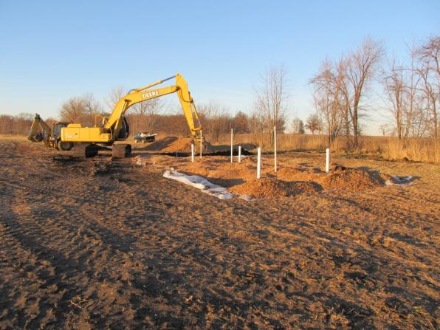
Woodchip bioreactors

Slide 20
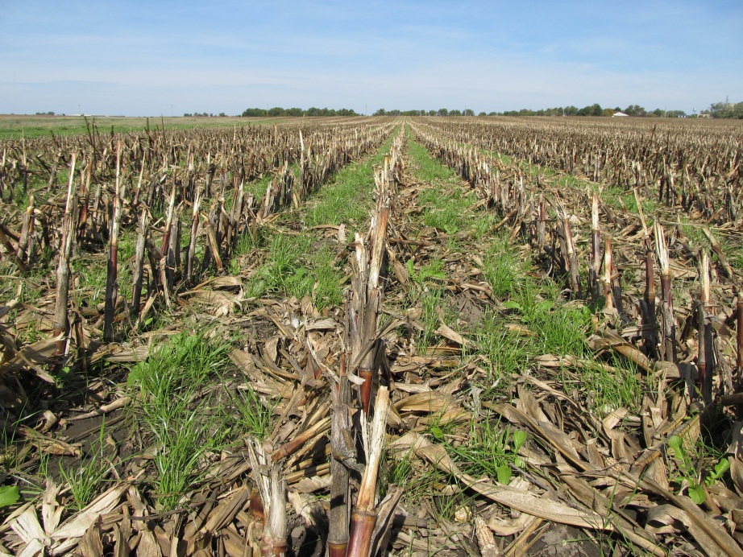
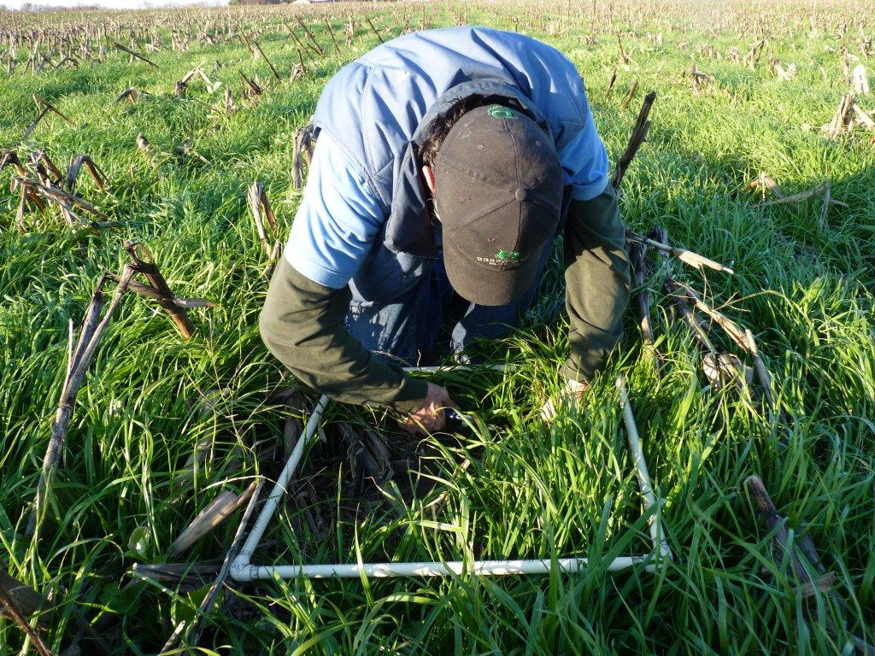
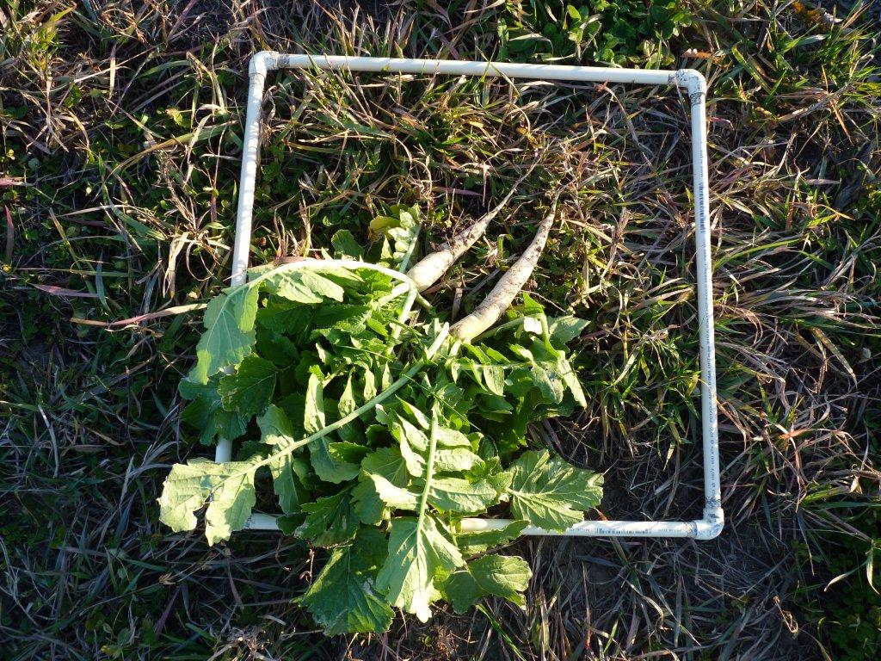
Annual ryegrass and radish
- aerial seeding 09-08-12
10-08-12
11-08-12
Tile installation
is faster than ever
Pattern systems
on 25 m
spacing

Slide 21
Nitrogen costs per acre
 | Practice/Scenario | Cost Per Acre | Notes
 | Reducing N rate from background to the MRTN (10% of acres) | -$8 | Reduce N rates (20 pounds)
 | Nitrification inhibitor with all fall applied fertilizer on tile-drained corn acres | $7 | Cost of inhibitor
 | Split (50%) fall and spring (50%) on tile-drained corn acres | $17 | Additional field pass, switch to N solutions
 | Fall to spring on tile-drained corn acres | $18 | Switch to N solutions, higher ammonia price, additional application costs
 | Cover crops on all corn/soybean tile-drained acres | $29 | Aerial applications of cereal rye
 | Cover crops on all corn/soybean non-tiled acres | $29 | Aerial applications of cereal rye
 | Bioreactors on 50% of tile-drained land | $17 | Upfront costs of $133 per acre
 | Wetlands on 25% of tile-drained land | $60 | 5% of farmland out of production Major cost is land ($11,000)
 | Buffers on all applicable crop land (reduction only for water that interacts with active area) | $294 per buffer acre | Land costs plus $50 planting, $10 yearly maintenance
 | Perennial/energy crops equal to pasture/hay acreage from 1987 | $86 | Less profit compared to corn-soybean rotation
 | Perennial/energy crops on 10% of tile-drained land | $86 | Less profit compared to corn-soybean rotation
In-field
Edge-of-field
Land use change

Slide 22
Phosphorus costs per acre
 | Practice/Scenario | Cost Per Acre | Notes
 | Reduce tillage | -$16 | Eliminate one pass of heavy equipment, no change in yield
 | No P fertilizer on 12.5 million ac of CS fields with soil test P above maintenance level for average of 6 years | -$15 | Cost of six years of P fertilizer averaged over 20 years.
 | Cover crops on corn/soybean tile-drained acres | $29 | Aerial applications of cereal rye
 | Cover crops on corn/soybean non-tiled acres | $29 | Aerial applications of cereal rye
 | Bioreactors on 50% of tile-drained land | $17 | Upfront costs of $133 per acre
 | Wetlands on 25% of tile-drained land | $60 | 5% of farmland out of production Major cost is land ($11,000)
 | Buffers on all applicable crop land (reduction only for water that interacts with active area) | $294 per buffer acre | Land costs plus $50 planting, $10 yearly maintenance
 | Perennial/energy crops equal to pasture/hay acreage from 1987 | $86 | Less profit compared to corn-soybean rotation
 | Perennial/energy crops on 10% of tile-drained land | $86 | Less profit compared to corn-soybean rotation
In-field
Edge-of-field
Land use change
Notes:
Costs are all annualized to put on the same basis. Some have substantial first year costs.

Slide 23
Example Statewide Results for N
 | Practice/Scenario | Nitrate-N reduction per acre (%) | Nitrate-N reduced (million lb N) | Nitrate-N Reduction % (from baseline) | Cost ($/lb N removed)
 | Baseline |  | 410
 | Reducing N rate from background to the MRTN (10% of acres) | 10 | 2.3 | 0.6 | -4.25
 | Nitrification inhibitor with all fall applied fertilizer on tile-drained corn acres | 10 | 4.3 | 1.0 | 2.33
 | Split (50%) fall and spring (50%) on tile-drained corn acres | 7.5 to 10 | 13 | 3.1 | 6.22
 | Fall to spring on tile-drained corn acres | 15 to 20 | 26 | 6.4 | 3.17
 | Cover crops on all corn/soybean tile-drained acres | 30 | 84 | 20.5 | 3.21
 | Cover crops on all corn/soybean non-tiled acres | 30 | 33 | 7.9 | 11.02
 | Bioreactors on 50% of tile-drained land | 40 | 56 | 13.6 | 1.38
 | Wetlands on 25% of tile-drained land | 40 | 28 | 6.8 | 5.06
 | Buffers on all applicable crop land (reduction only for water that interacts with active area) | 90 | 36 | 8.7 | 1.63
 | Perennial/energy crops equal to pasture/hay acreage from 1987 | 90 | 10 | 2.6 | 9.34
 | Perennial/energy crops on 10% of tile-drained land | 90 | 25 | 6.1 | 3.18
 | Point source reduction to 10 mg nitrate-N/L |  | 14 | 3.4 | 3.30
 | Point source reduction in N due to biological nutrient removal for P |  | 8 | 1.8
In-field
Edge-of-field
Land use change
Point source
Notes:
This table is for nitrate reductions and applies each practice individually for the entire state to a maximum amount. It is useful to see what the impact is and the cost per lb removed. The reductions are not necessarily additive here.

Slide 24
Example Statewide Results for P
 | Practice/Scenario | Total P reduction per acre (%) | Total P reduced (million lb P) | Total P Reduction % (from baseline) | Cost ($/lb P removed)
 | Baseline |  | 37.5
 | Convert 1.8 million acres of conventional till eroding >T to reduced, mulch or no-till | 50 | 1.8 | 5.0 | -16.60
 | P rate reduction on fields with soil test P above the recommended maintenance level | 7 | 1.9 | 5.0 | -48.75
 | Cover crops on all corn/soybean acres | 30 | 4.8 | 12.8 | 130.40
 | Cover crops on 1.6 million acres eroding>T currently in reduced, mulch or no-till | 50 | 1.9 | 5.0 | 24.50
 | Wetlands on 25% of tile-drained land | 0 | 0 | 0.0
 | Buffers on all applicable crop land | 25-50 | 4.8 | 12.9 | 11.97
 | Perennial/energy crops equal to pasture/hay acreage from 1987 | 90 | 0.9 | 2.5 | 102.30
 | Perennial/energy crops on 1.6 million acres>T currently in reduced, mulch or no-till | 90 | 3.5 | 9.0 | 40.40
 | Perennial/energy crops on 10% of tile-drained land | 50 | 0.3 | 0.8 | 250.07
 | Point source reduction to 1.0 mg total P/L (majors only) |  | 8.3 | 22.1 | 13.71
In-field
Edge-of-field
Land use change
Point source
USLE method
Notes:
This table is for total P reductions and applies each practice individually for the entire state to a maximum amount. It is useful to see what the impact is and the cost per lb removed. The reductions are not necessarily additive here.

Slide 25
Example Statewide N & P Scenarios
Name | Combined Practices and/or Scenarios | Nitrate-N (% reduction) | Total P (% reduction) | Cost of Reduction ($/lb) | Annualized Costs (million $/year)
NP1 | MRTN, fall to spring, bioreactors 50%, wetlands 25%, no P fert. on 12.5 million ac above STP maintenance, reduced till on 1.8 million ac conv. till eroding > T, buffers on all applicable lands, point source to 1.0 mg TP/L and 10 mg nitrate-N/L | 35 | 45 | ** | 383
NP2 | MRTN, fall to spring, bioreactors 50%, no P fert. on 12.5 million ac above STP maintenance, reduced till on 1.8 million ac conv. till eroding > T, cover crops on all CS, point source to 1.0 mg TP/L and 10 mg nitrate-N/L | 45 | 45 | ** | 810
NP3 | MRTN, fall to spring, bioreactors 15%, no P fert. on 12.5 million ac above STP maintenance, reduced till on 1.8 million ac conv. till eroding > T, cover crops on 87.5% of CS, buffers on all applicable lands, perennial crops on 1.6 million ac >T, and 0.9 million additional ac. | 45 | 45 | ** | 791
NP4 | MRTN, fall to spring N, bioreactors 35%, no P fert. on 12.5 million ac above STP maintenance, reduced till on 1.8 million ac conv. till eroding > T, buffers on 80% of all applicable land | 20 | 20 | ** | 48
NP5 | MRTN, fall to spring N, bioreactors 30%, wetlands 15%, no P fert. on 12.5 million ac above STP maintenance, reduced till on 1.8 million ac conv. till eroding > T, point source to 1.0 mg TP/L and 10 mg nitrate-N/L on 45% of discharge | 20 | 20 | ** | 66
NP6 | MRTN, fall to spring N, no P fert. on 12.5 million ac above STP maintenance, reduced till on 1.8 million ac conv. till eroding > T, cover crops on 1.6 million ac eroding >T and 40% of all other CS | 24 | 20 | ** | 244
Notes:
Here we try to optimize both nitrate-N and total P reduction strategies. Cost per lb can’t really be calculated at this point. NP4 and NP5 save $ because of P changes at the 20% reduction level.

Slide 26
Combined scenarios with costs by practice (million $ per year)
Practice | NP1 | NP2 | NP3 | NP4 | NP5 | NP6
MRTN | -9.6 | -9.6 | -9.6 | -9.6 | -9.6 | -9.6
N fertilizer timing | 82 | 82 | 82 | 82 | 82 | 82
Bioreactors | 77 | 77 | 23 | 54 | 46
Wetlands | 140
Buffers | 58 |  | 58 | 46
Cover crops |  | 625 | 547 |  |  | 296
Perennials |  |  | 215
Reduced P fertilizer | -94 | -94 | -94 | -94 | -94 | -94
Reduced tillage | -30 | -30 | -30 | -30 | -30 | -30
Point source P | 114 | 114 |  |  | 51
Point source N | 46 | 46 |  |  | 21
Sum | 383 | 810 | 791 | 48 | 66 | 244

Slide 27
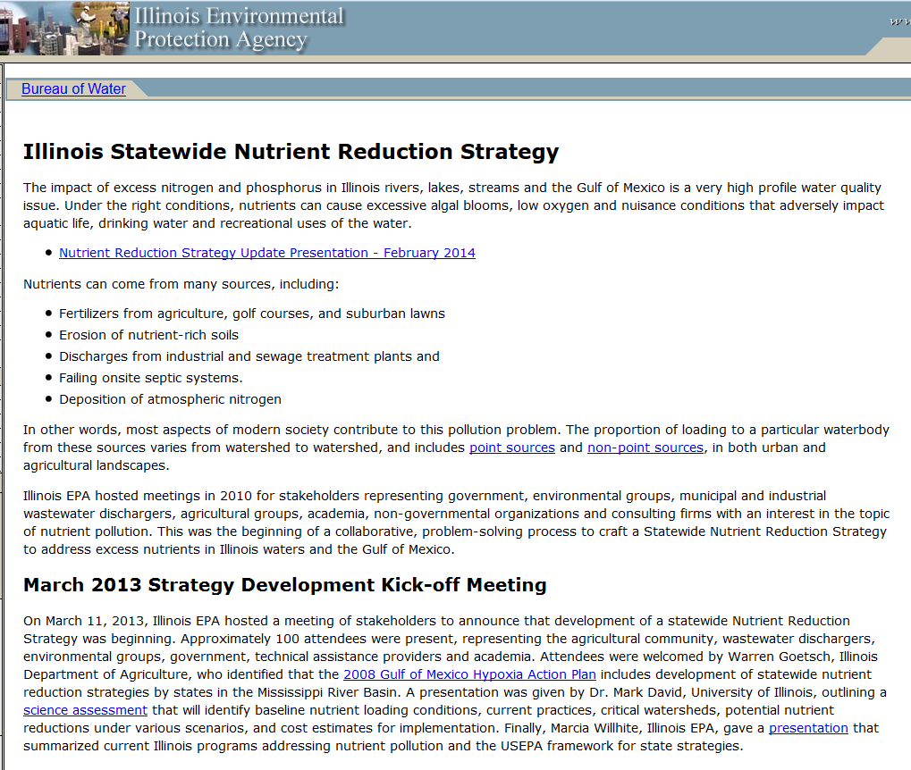
http://www.epa.state.il.us/water/nutrient/index.html

Slide 28
IEPA and Dept. of Agriculture
two agencies have led process
series of meetings with stakeholders in state
I made presentations as science assessment was developed
more recent meetings to develop strategy
final meeting in May
drafts of strategy have been released for comment
three groups represented
agriculture, point source, and environmental groups

Slide 29
Public meetings

Slide 30
Agriculture Subcommittee Survey
Practice | Median adoption rate (%) | N reduction (million lb N) | P reduction (million lb P)
Timing change (either fall to spring or fall/spring/side dress) | 65 | 17 | 0
Cover crops – tile drained corn and soybean acres | 25 | 21 | 0.5
Ephemeral gulley control | 65 | ? | ?
Buffers on ag streams | 50 | 13 | 2.4
Wetlands on tile drained acres | 10 | 11 | 0
No P fertilizers with STP above maintenance | 78 | 0 | 1.5
No manure application on frozen ground | 93 | ? | ?
Convert 1.8 million acres of conventional till eroding > T to reduced, mulch, or no till | 60 | 0 | 1.1
Summed |  | 60 (15%) | 5.5 (15%)
Notes:
If all these practices were adopted by 2025 there would be about a 15% reduction both nitrate and total P stream loads from agriculture.

Slide 31
Conclusions
no simple solution, or one method to achieve goals
will take a range of point and non point source reductions to meet targets
initial focus could be:
point source P reductions ($114 million per year)
tile-drained nitrate reductions by agriculture (range of costs)
strategy to get us started

